Slide 1

Exclusive Chettinadu Sarees
CONTACT US
Hudson Agile Technologies LLC
317 George Street, 3rd Floor, New Brunswick,
New Jersey- 08901 United States of America
E mail ID:exportclients@hudsonagileventures.com

Slide 2
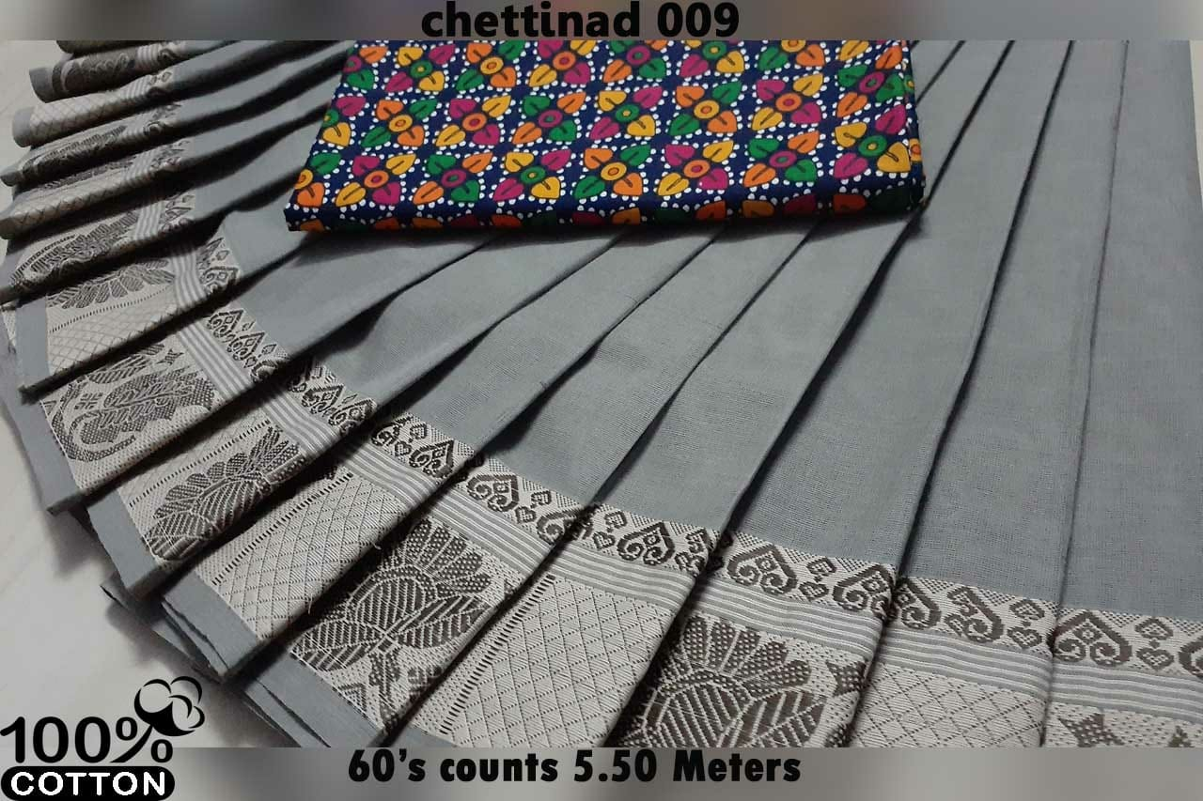
HCD-1
15.5$

Slide 3
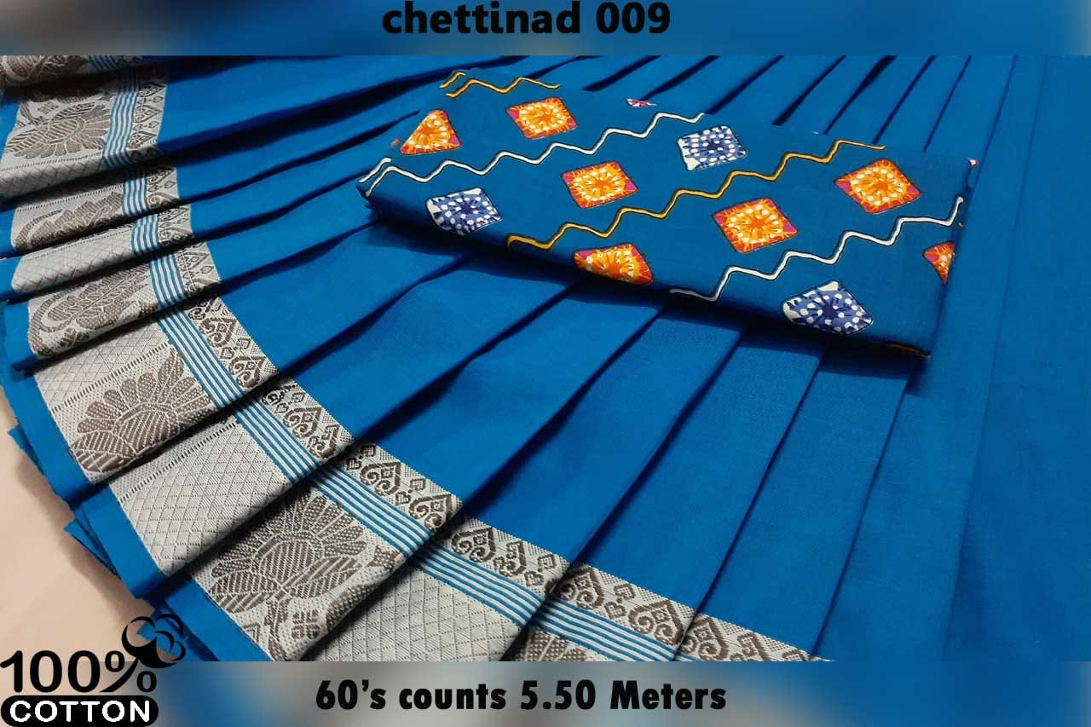
HCD-2
15.5$

Slide 4
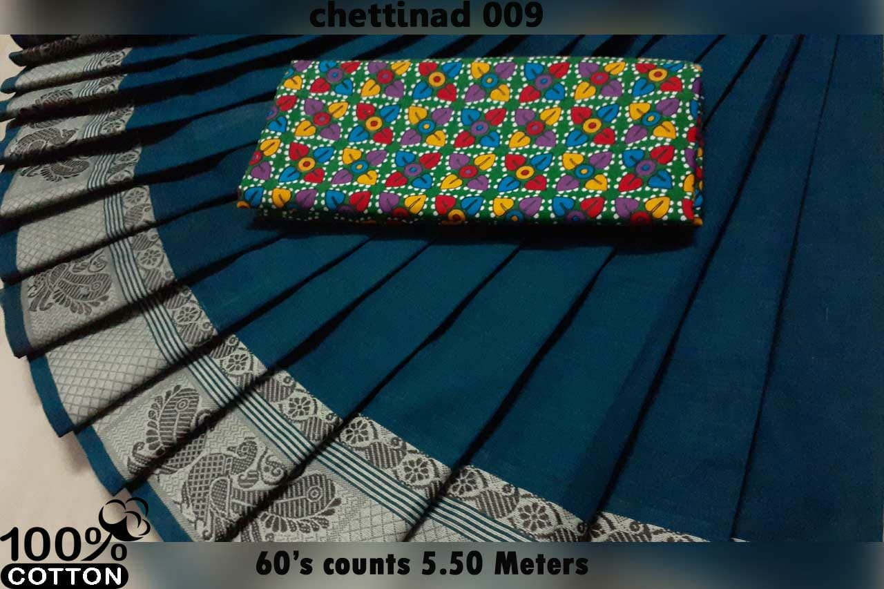
HCD-3
15.5$

Slide 5
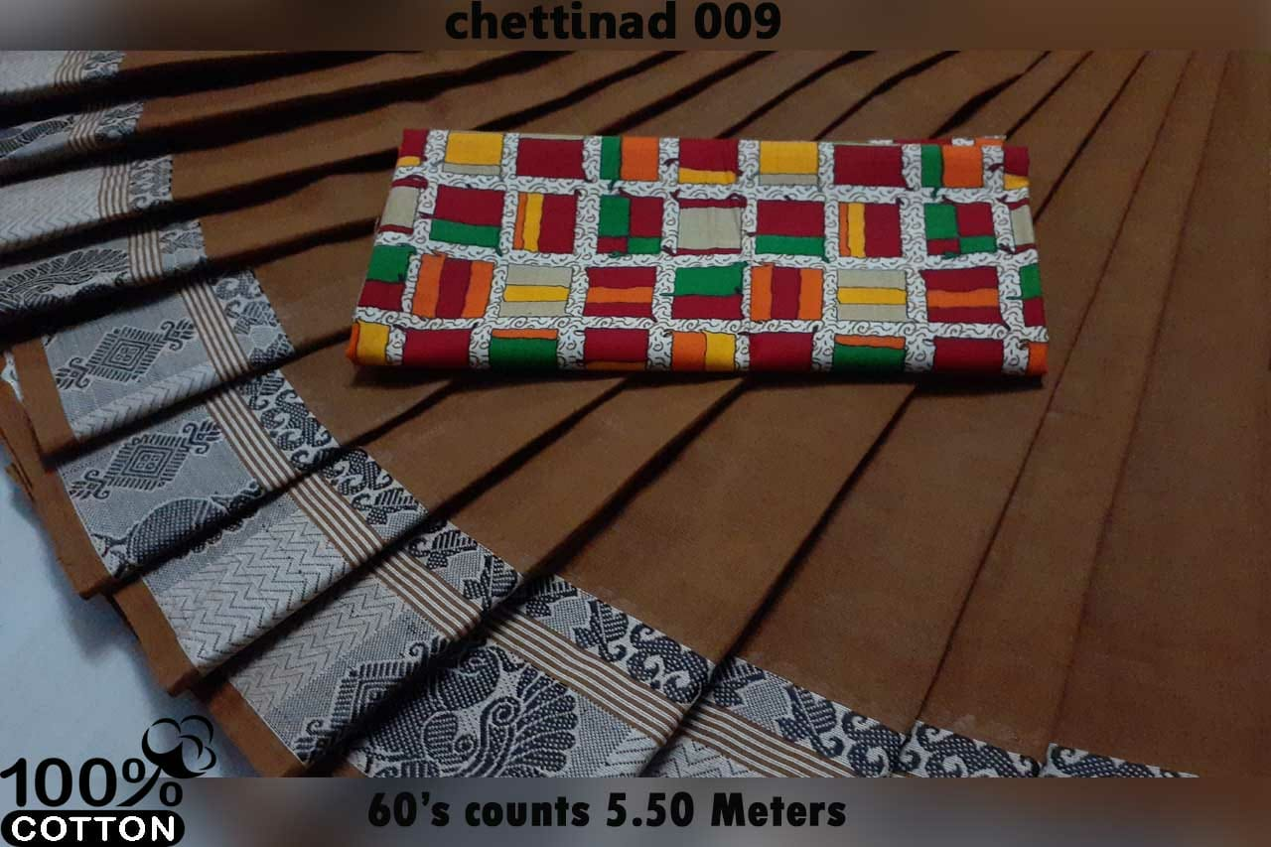
HCD-4
15.5$

Slide 6
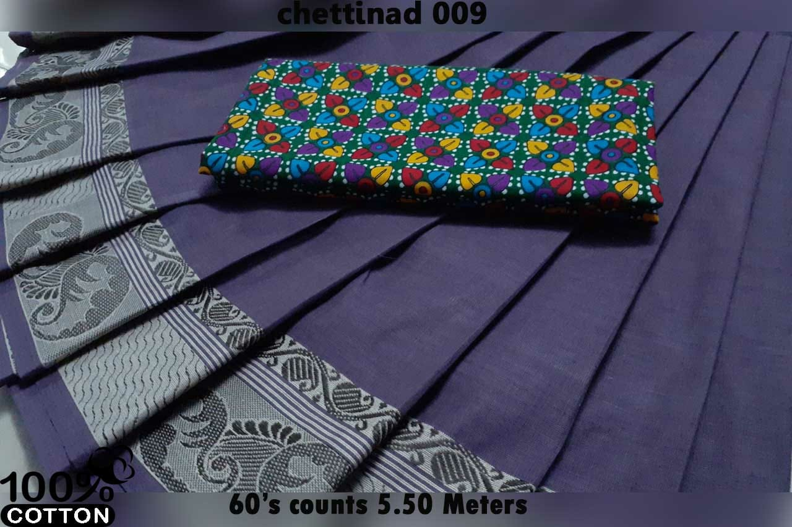
HCD-5
15.5$

Slide 7
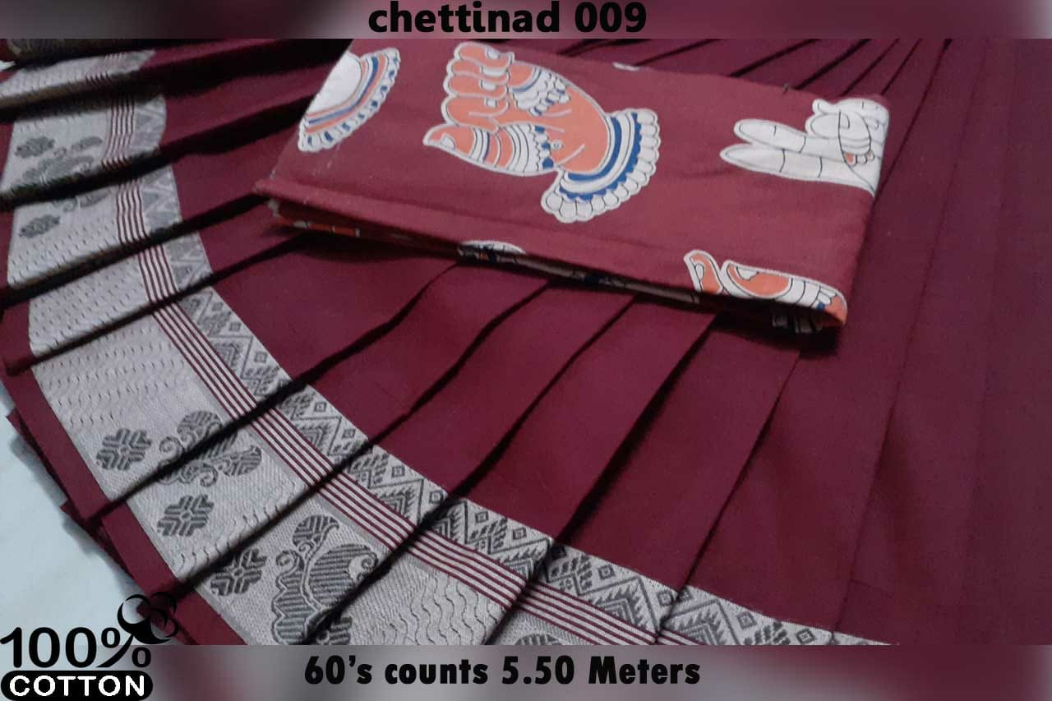
HCD-6
15.5$

Slide 8
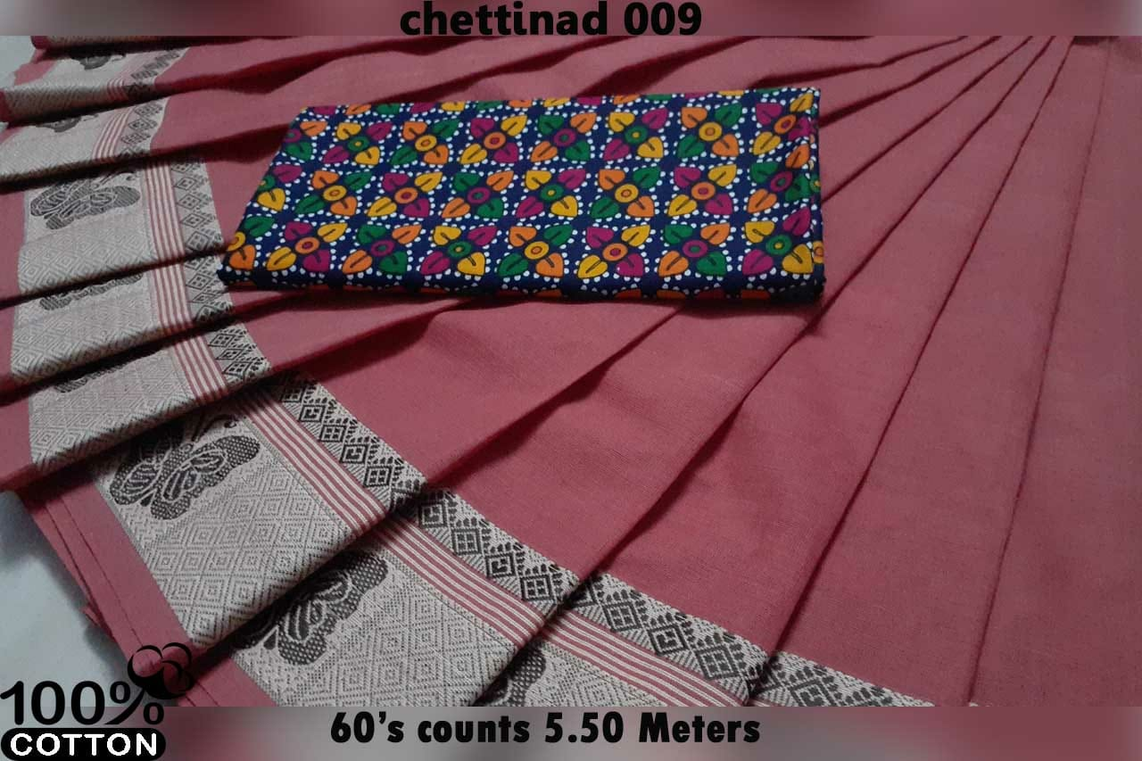
HCD-7
15.5$

Slide 9
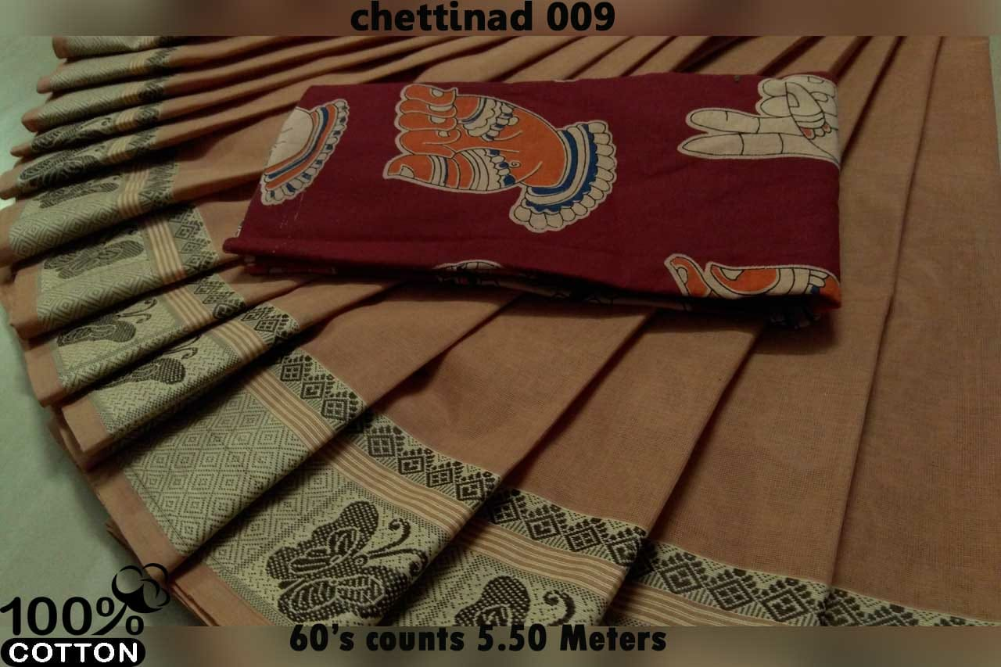
HCD-8
15.5$

Slide 10
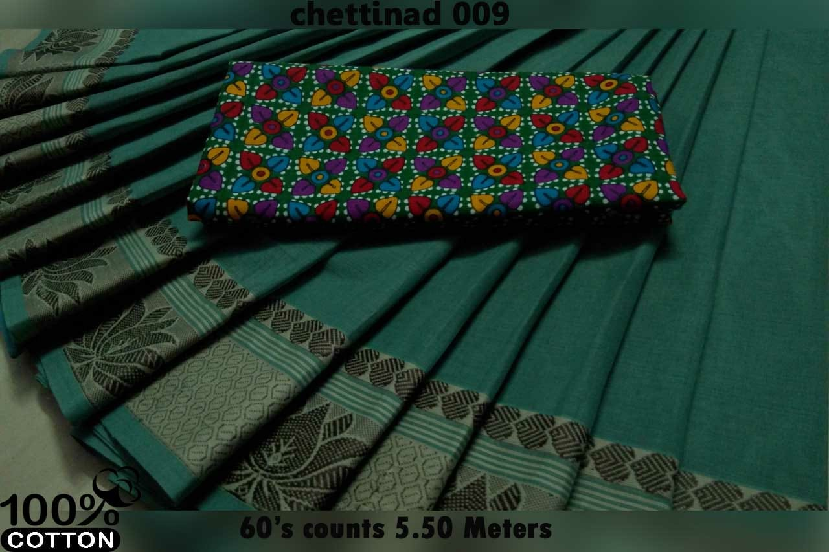
HCD-9
15.5$

Slide 11
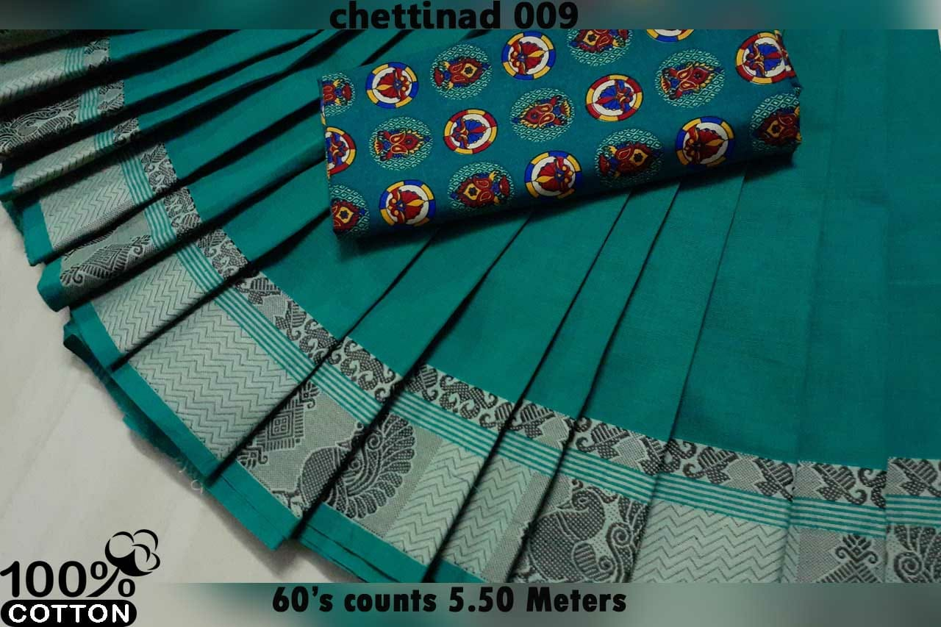
HCD-10
15.5$

Slide 12
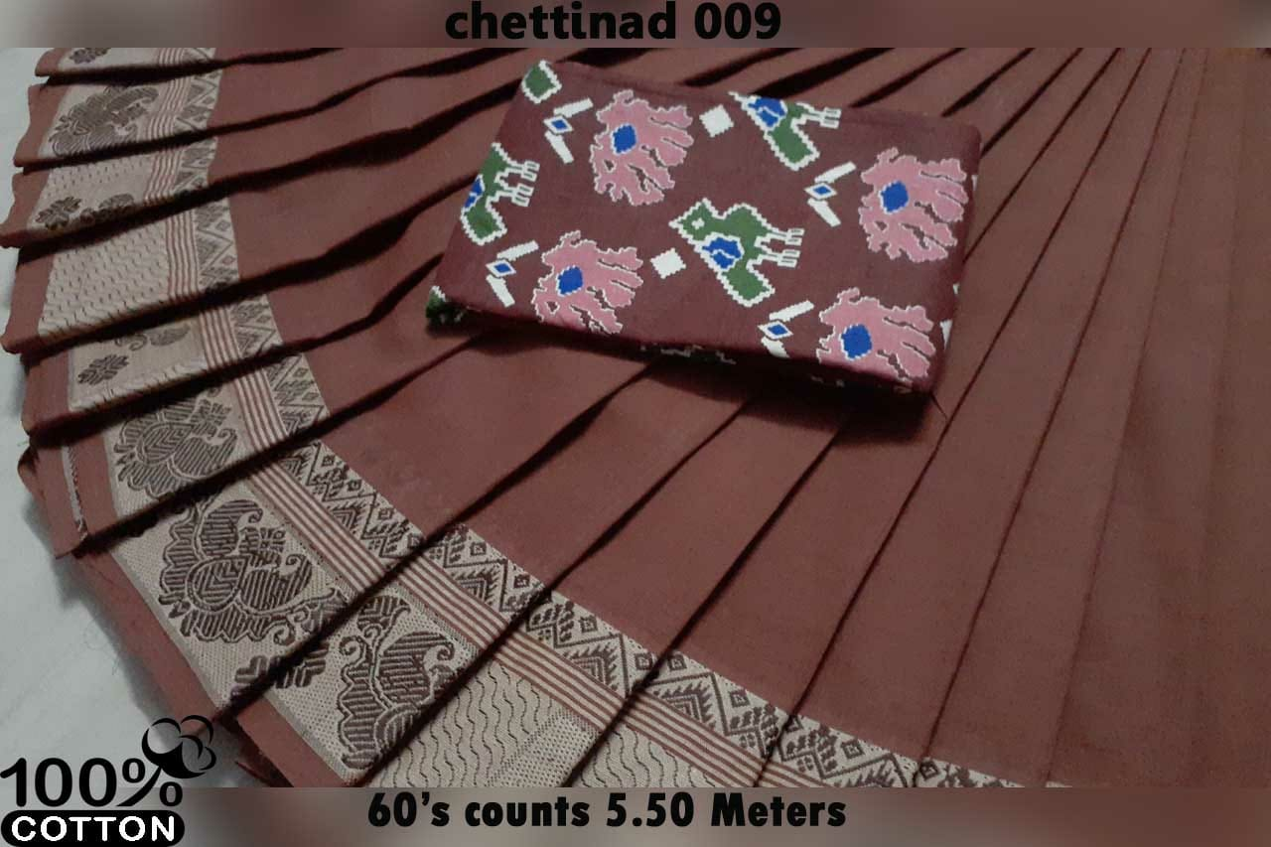
HCD-11
15.5$

Slide 13
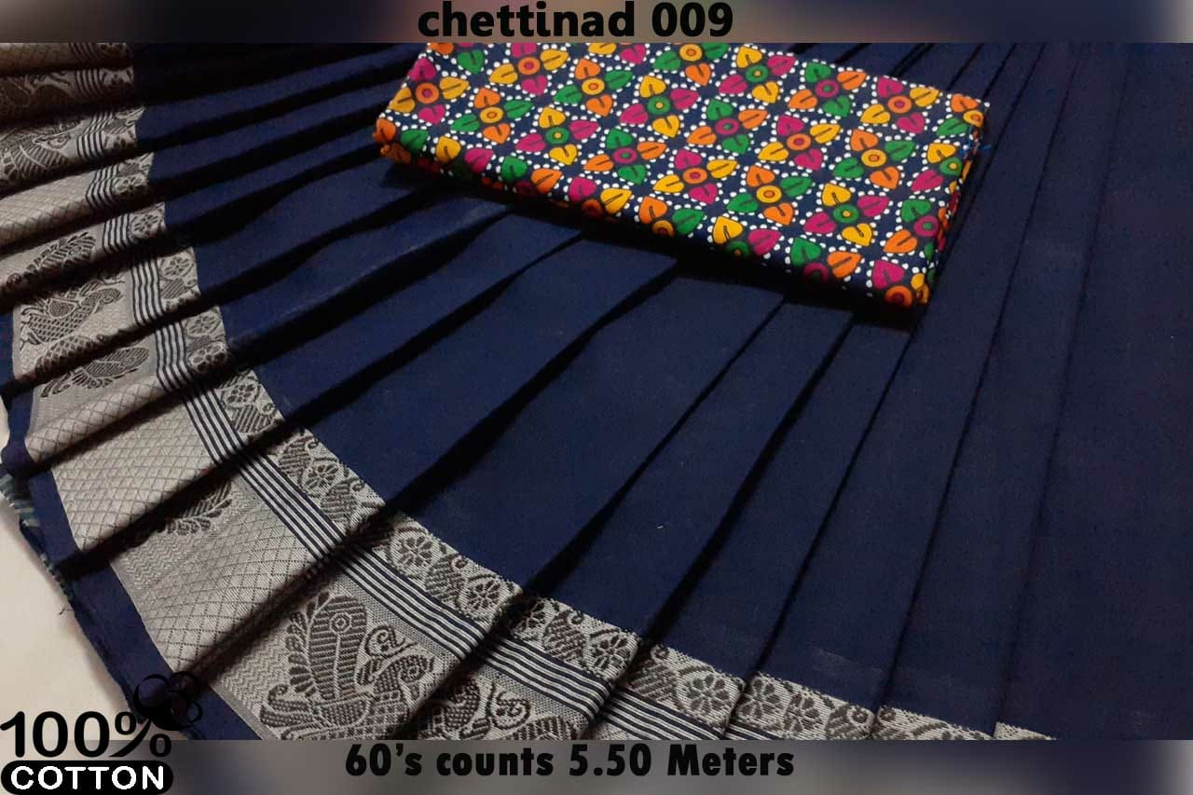
HCD-12
15.5$

Slide 14
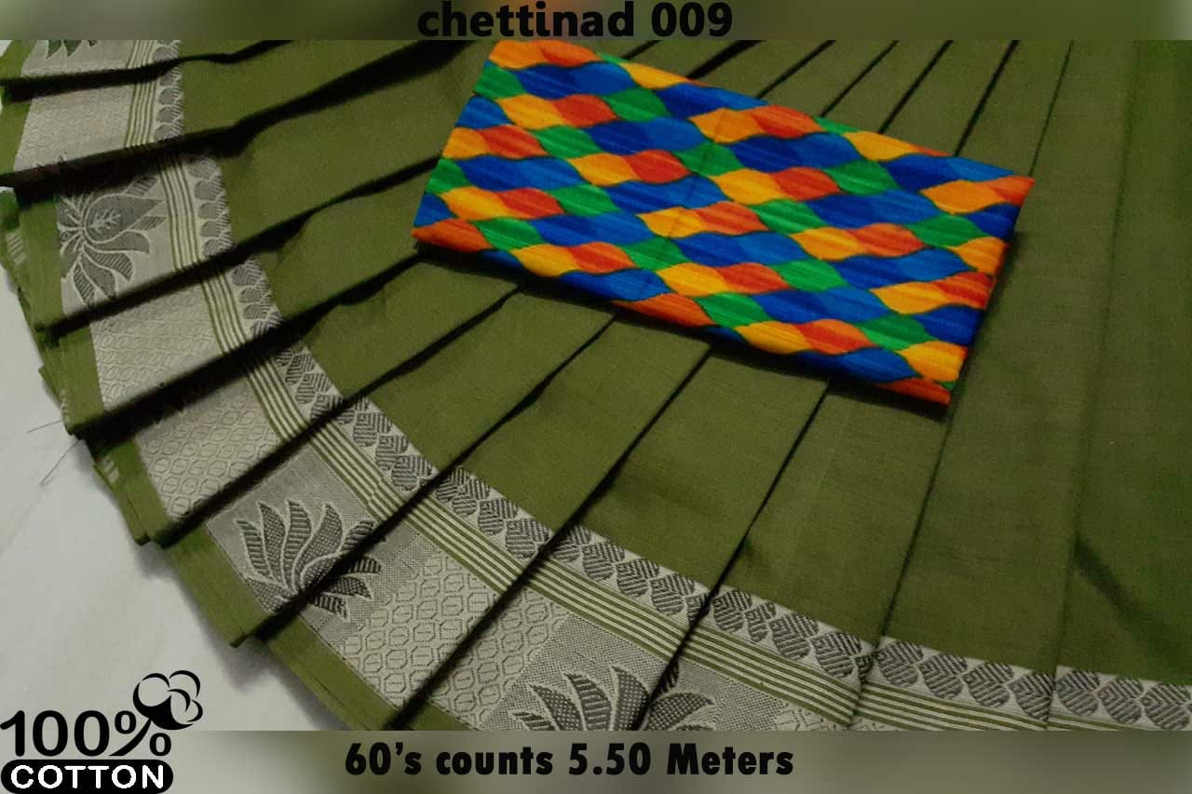
HCD-13
15.5$

Slide 15
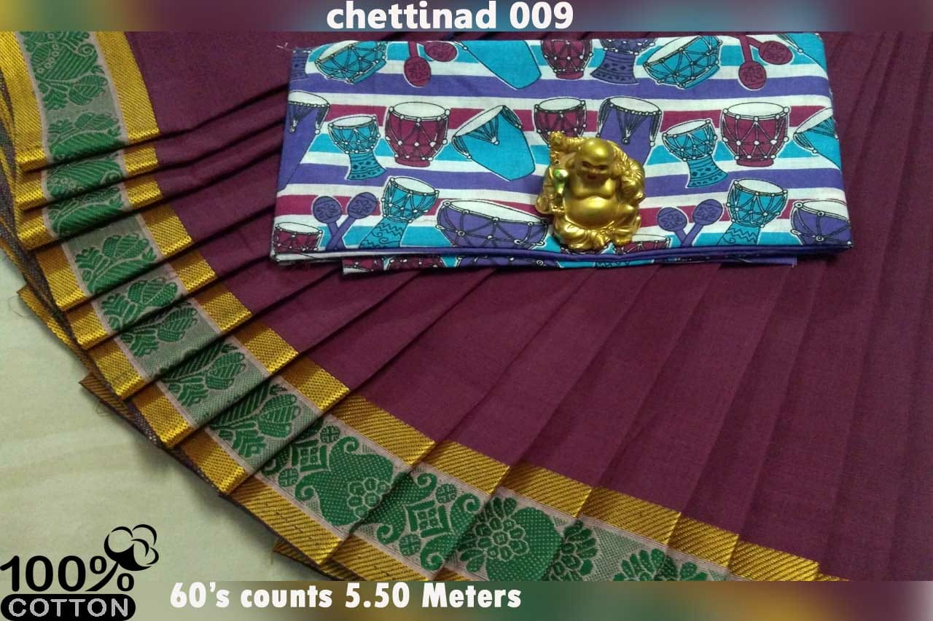
HCD-14
15.5$

Slide 16
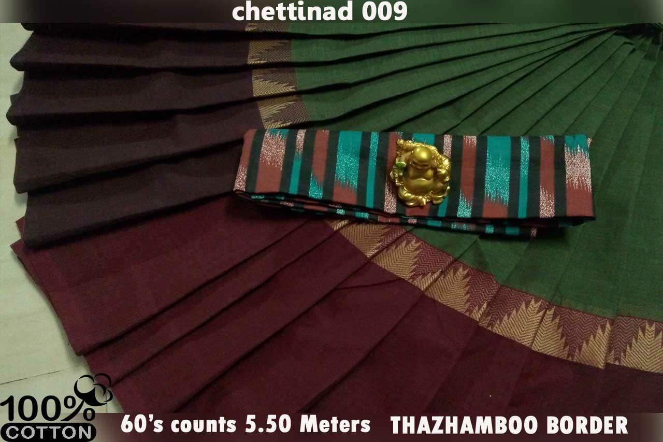
HCD-15
15.5$

Slide 17
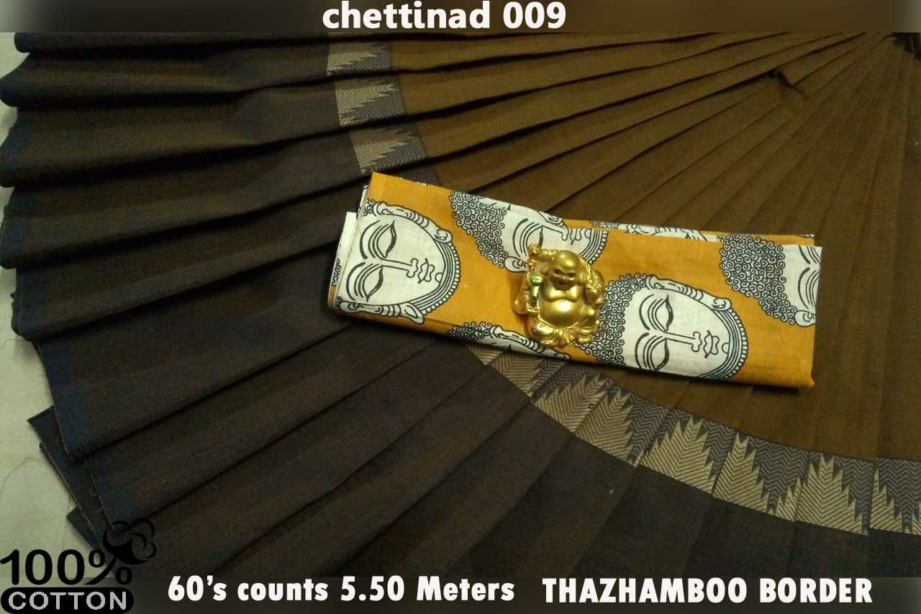
HCD-16
15.5$

Slide 18
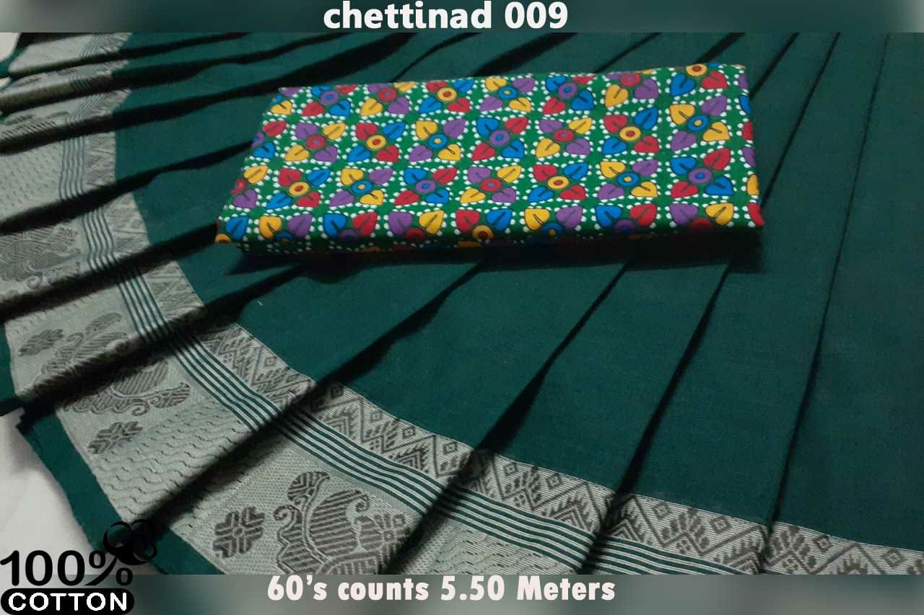
HCD-17
15.5$

Slide 19
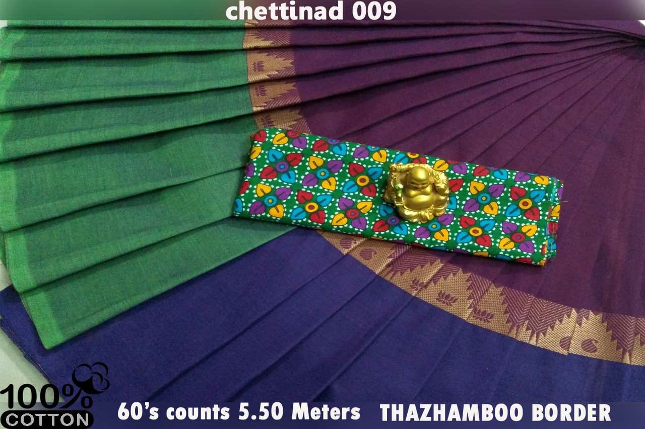
HCD-18
15.5$

Slide 20
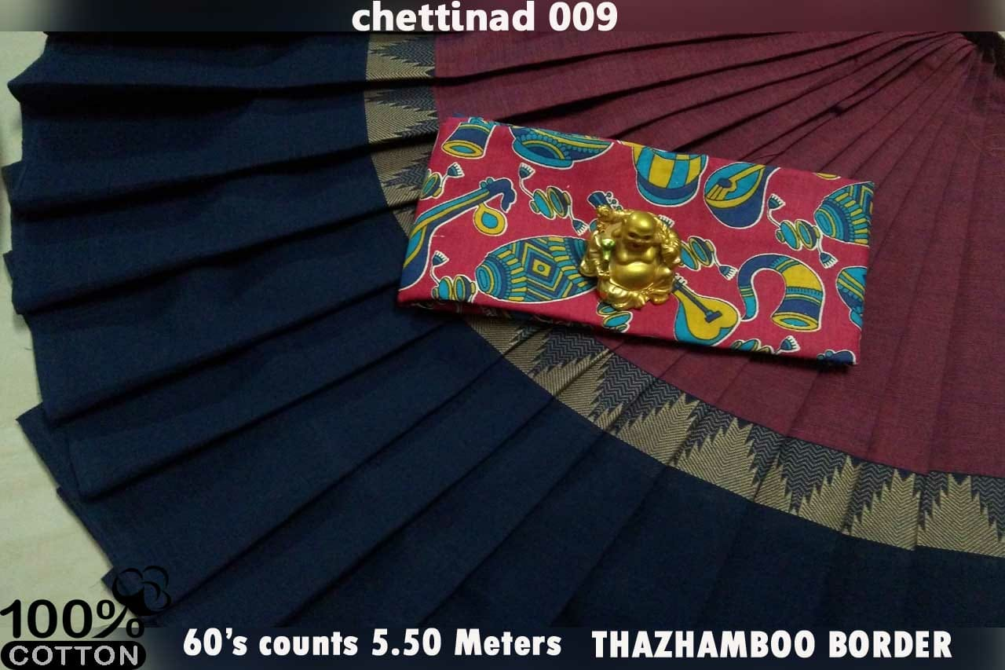
HCD-19
15.5$

Slide 21
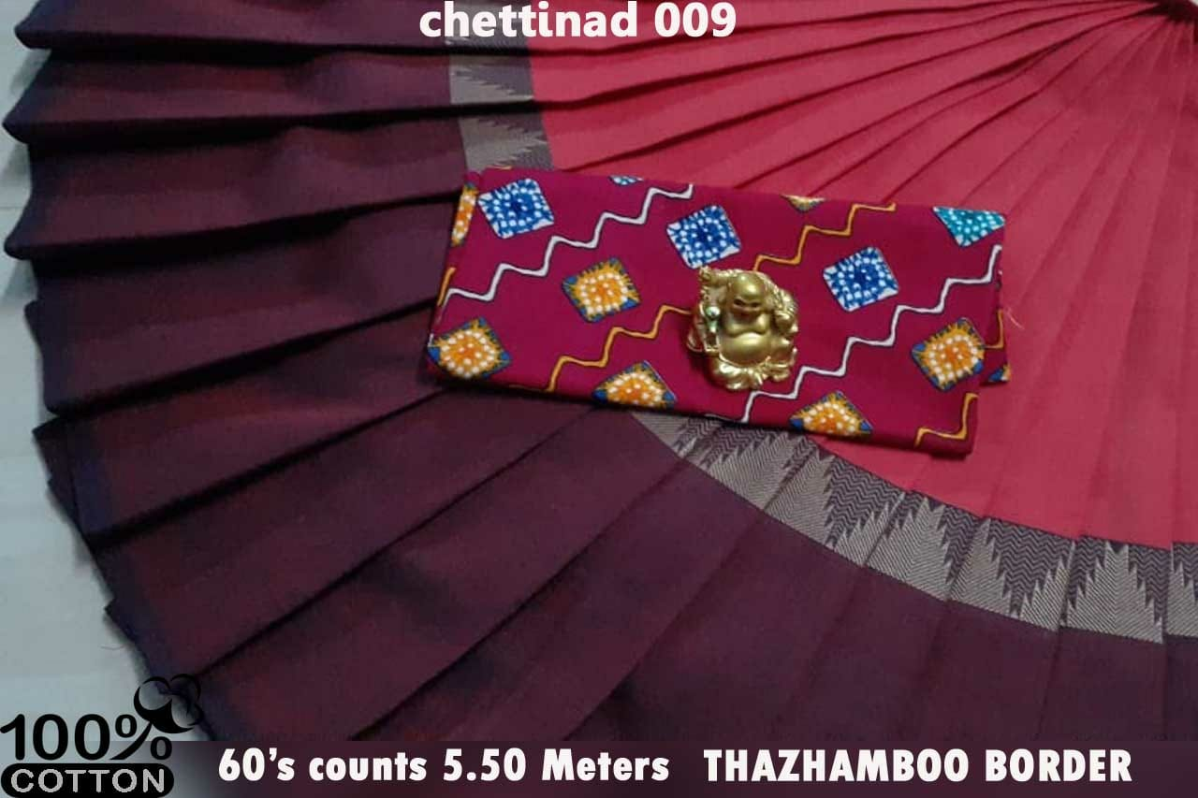
Hcd-20
15.5$

Slide 22
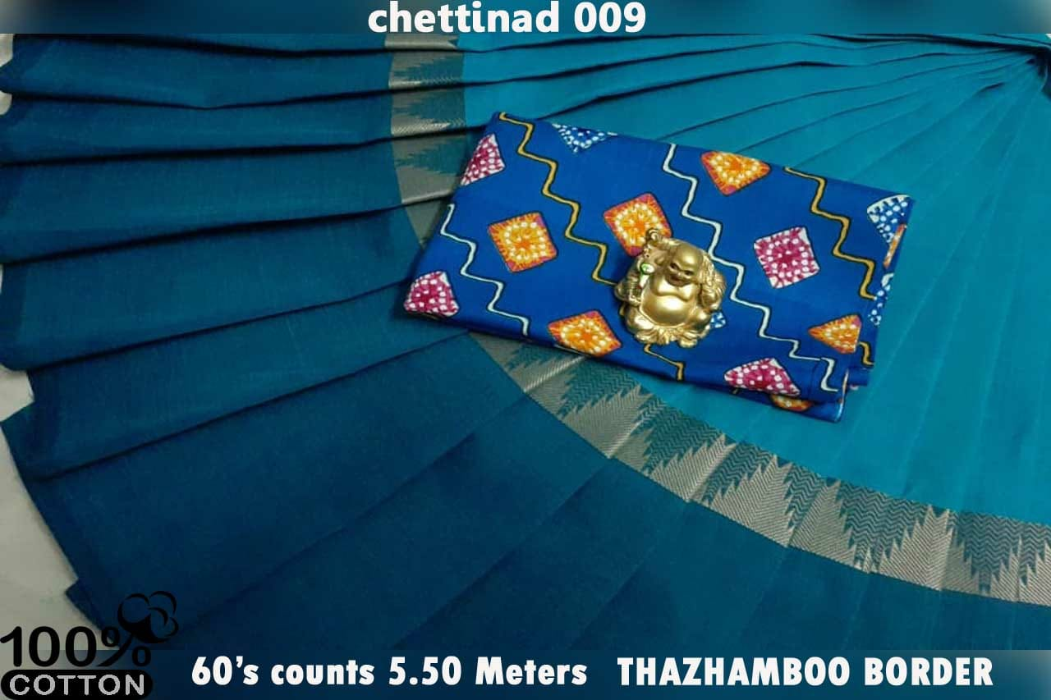
Hcd-21
15.5$

Slide 23
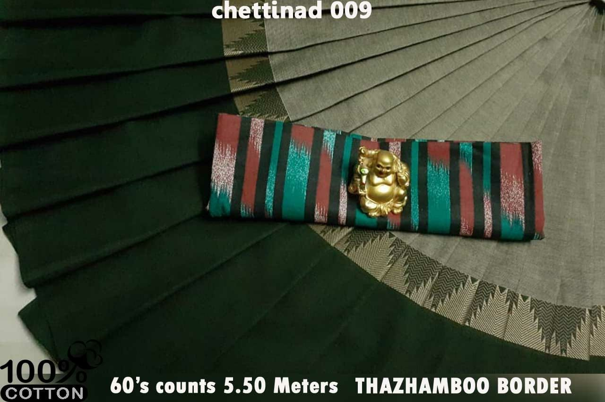
Hcd-22
15.5$

Slide 24
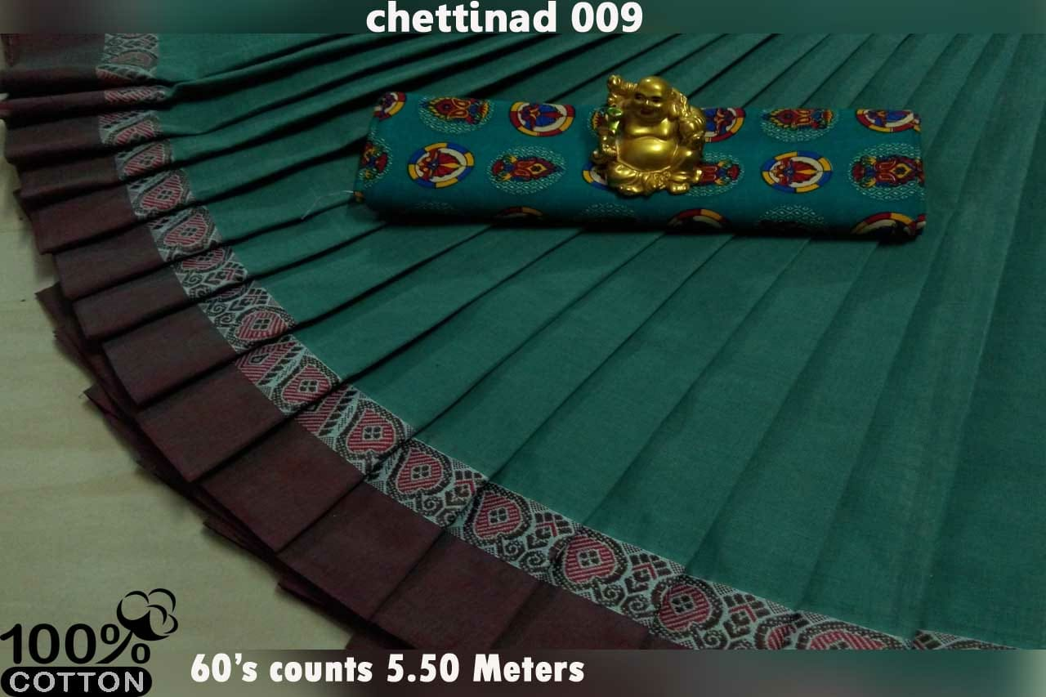
Hcd-23
15.5$

Slide 25
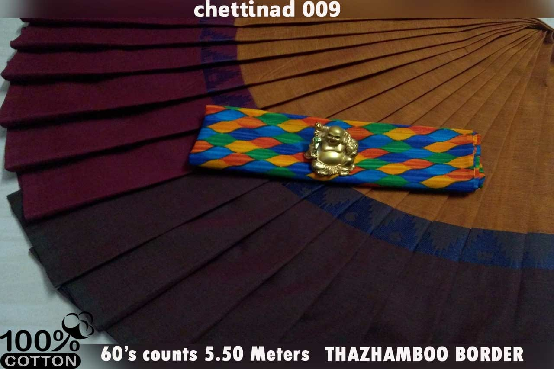
Hcd-24
15.5$

Slide 26
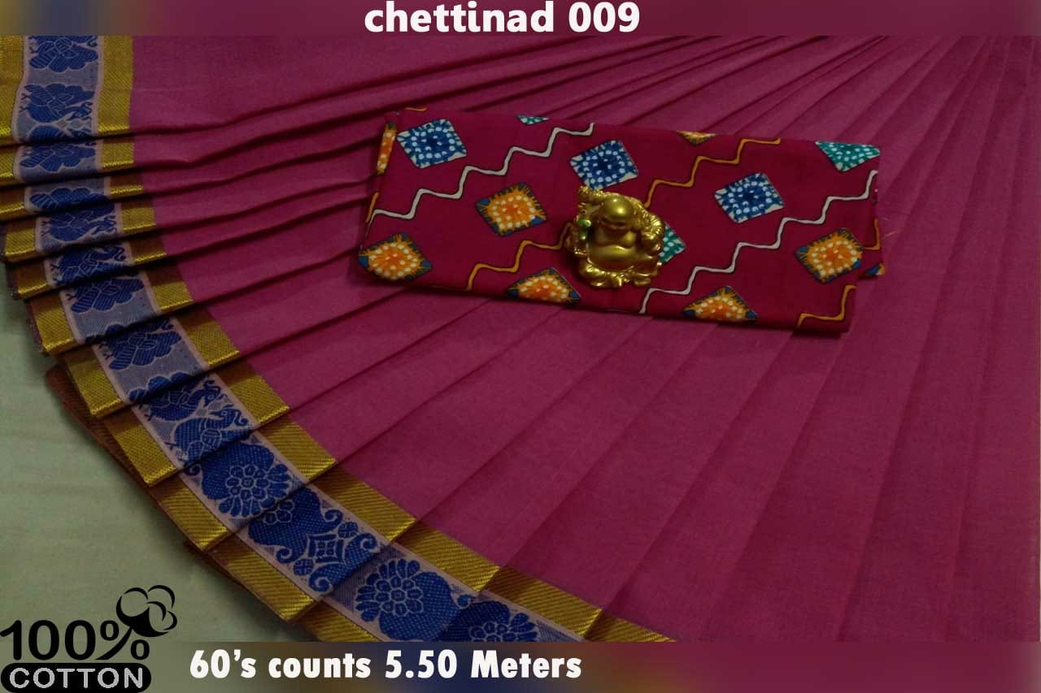
Hcd-25
15.5$

Slide 27
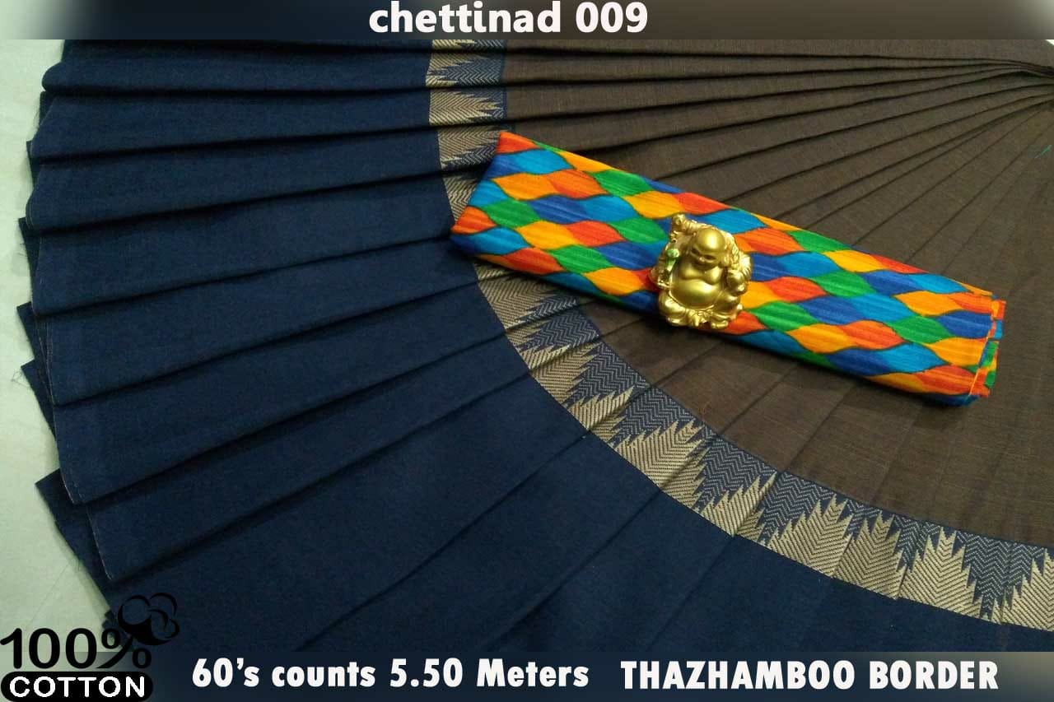
Hcd-26
15.5$

Slide 28
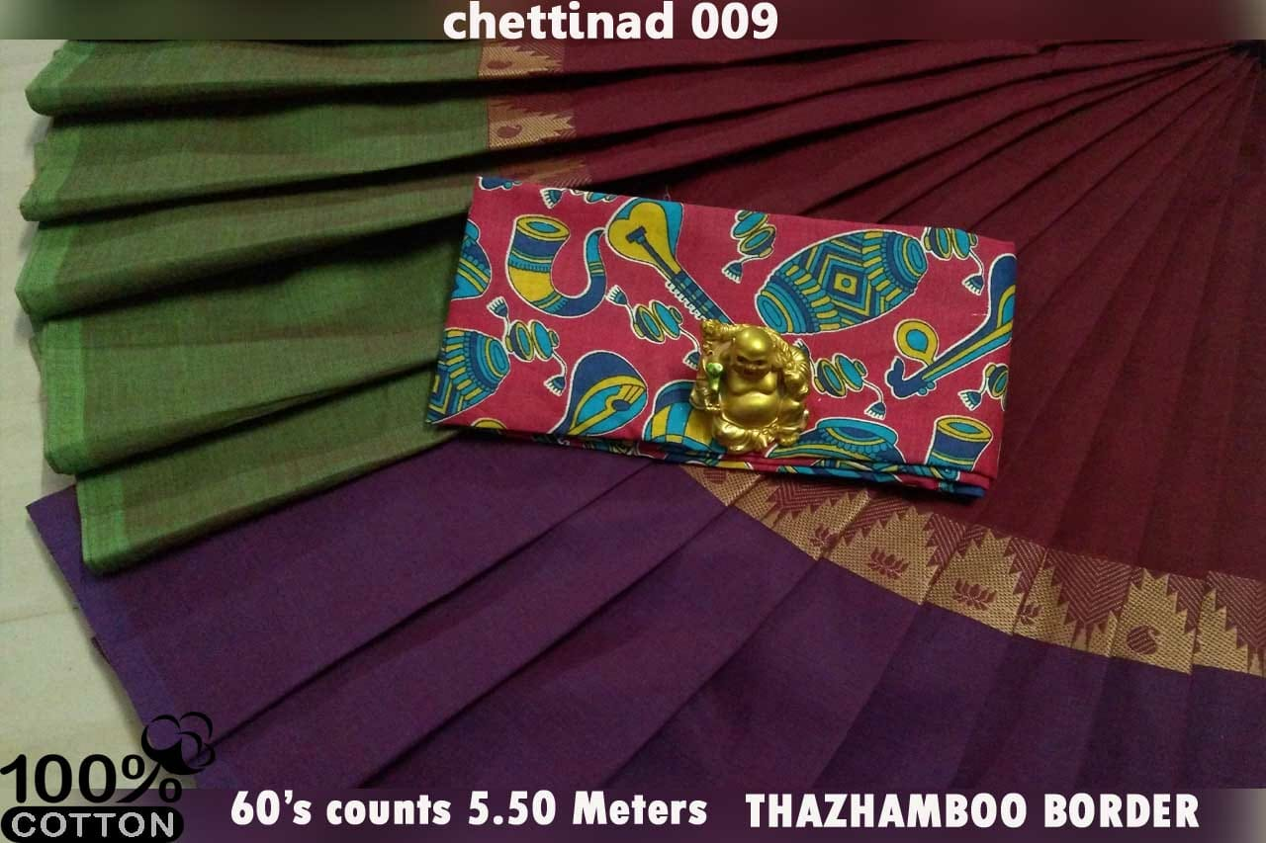
Hcd-27
15.5$

Slide 29
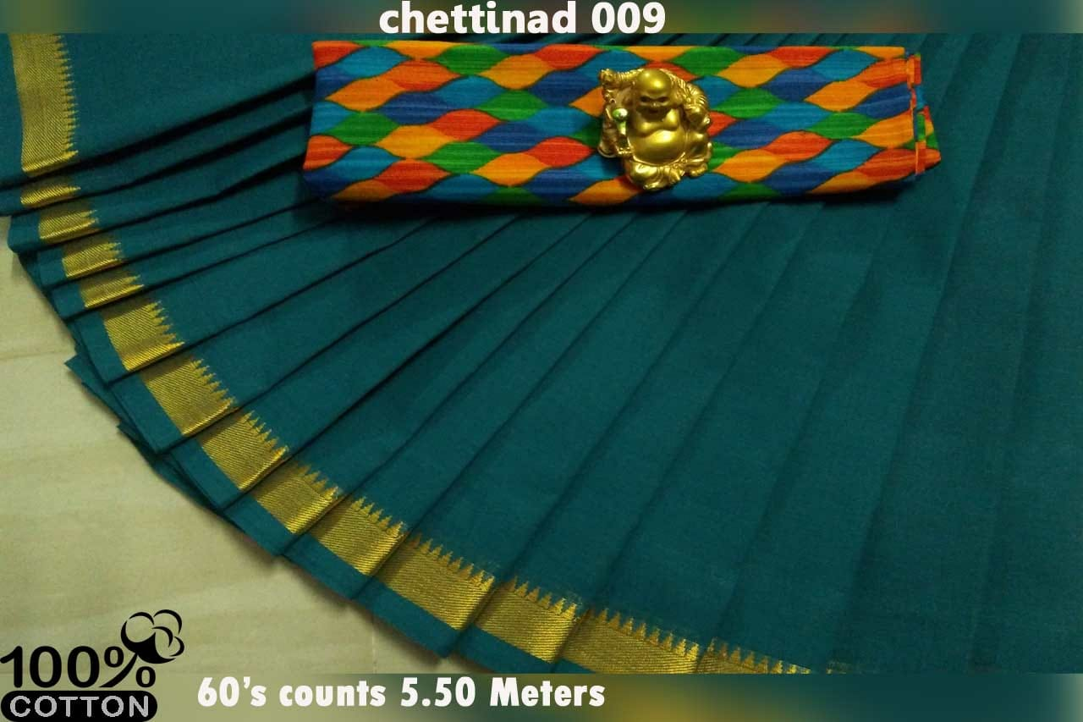
Hcd-28
15.5$

Slide 30
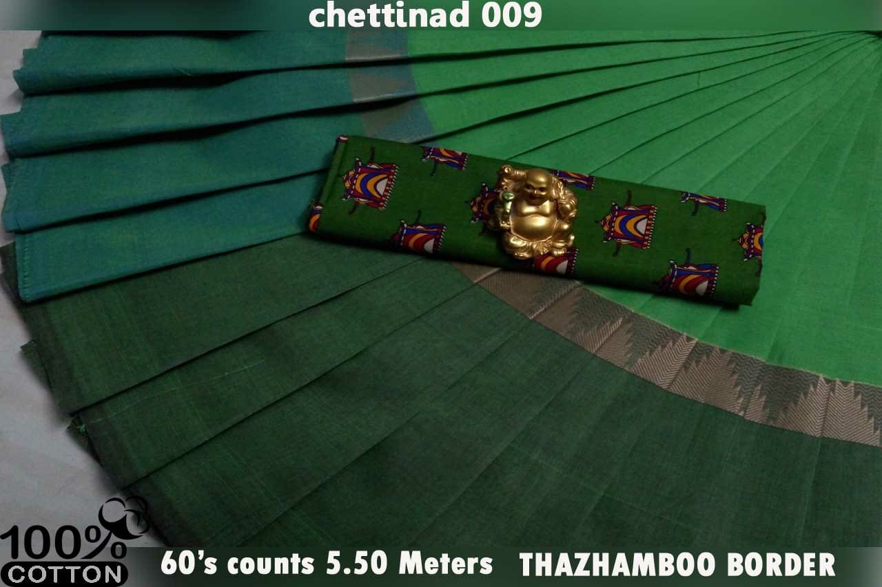
Hcd-29
15.5$

Slide 31
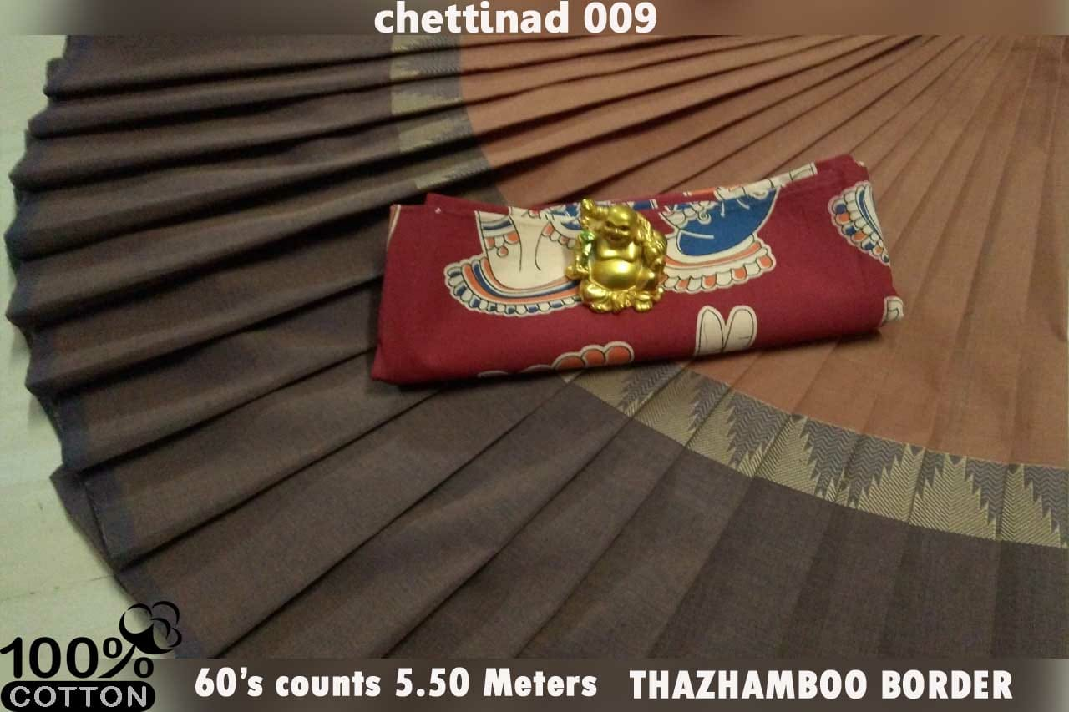
Hcd-30
15.5$

Slide 32
Thankyou
For more details please follow us on:
https://www.facebook.com/hudsonnjexpo

